Slide 1
Zapadno-Ozernoye and Verkhne-Telekaiskoye Oil, gas and condensate
NPO Economics and Direct Investment Development Fund of the Chukotka Autonomous Region
September 2017

Slide 2
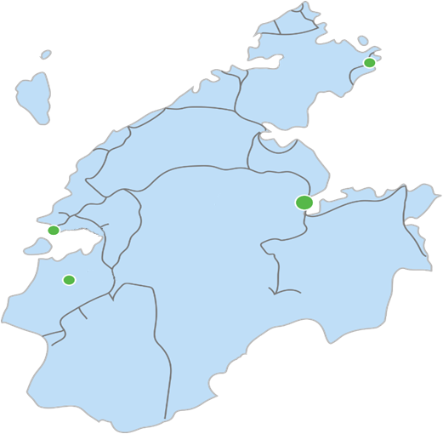
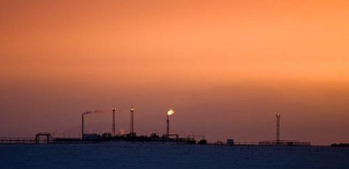
ZAPADNO-OZERNOYE AND VERKHNE-TELEKAISKOYE OIL, GAS AND CONDENSATE
NPO Economics and Direct Investment Development Fund of the Chukotka Autonomous Region
Location
FIELD RESERVES:
Oil and gas fields
Zapadno- Ozernoye
GAS 4.4 bn m³,
(production 65.1 mln m³ per year)
Provideniya
Vrangelya island
Anadyr
Pevek
Verkhne-
Telekaiskoye
OIL 2.8 mln tonnes
(production 4,915,000 tonnes per year)
Bilibino
GAS 2.0 bn m³
(production 1.9 bn m³ per year)
CONDENSATE, 100,000 m³.
Note: * distance from the fields to Anadyr is 103 km

Slide 3
IMPLEMENTATION STAGES PROJECT FOR PRODUCTION, TRANSPORTATION AND PROCESSING OF OIL AND GAS
NPO Economics and Direct Investment Development Fund of the Chukotka Autonomous Region
Completed stages
Zapadno-Ozernoye
Verkhne-
Telekaiskoye
Volume of future
investments 5.4 bn rubles.
Geological exploration and wells
Field development
-
-
-
Production
Transportation
-
-
Storage and processing
Distribution
-
35 mln m³
1921 mln m³
320,000 tonnes
-
Project effectiveness: >IRR 25%; NPV 24.2 bn rubles.; payback period 4.3 years, volume of reserves for 29 years.

Slide 4
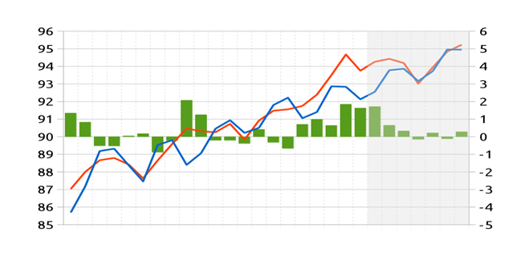
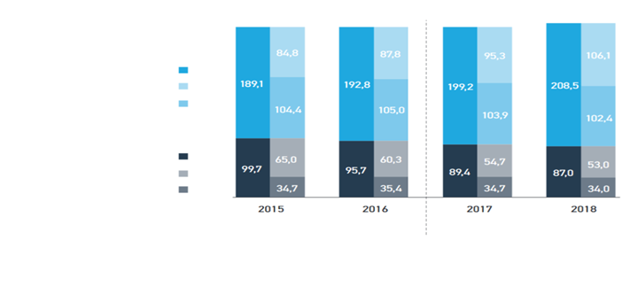
MARKET CAPACITY — KEY INDICES
NPO Economics and Direct Investment Development Fund of the Chukotka Autonomous Region
GAS in the region
OIL
World market
Balance between world production and consumption of liquid types of fuel
Zapadno-Ozernoye
Consumption per year ~ Production per year ~
Actual
mln m3
Forecast
mln m3
Available
volume for
distribu- tion
mln m3
Forecast
of consumption mln m3
Production
25.0
30.0
Production and consumption, MB/d
Underproduction, MB/d, Overproduction
Disbalance
Consumption
65.0
100.0
Forecast
Quarter 1
2010
Quarter 2
2011
Quarter 3
2012
Quarter 4
2013
Quarter 1
2015
Quarter 2
2016
«Selado» according to the data provided by EIA
Russian market
Verkhne-Telekaiskoye
Production (light)
Export (light)
Domestic consumption (light)
Production (dark)
Export (dark)
Domestic consumption (dark)
35.0
1921.0
160.0
ACTUAL
PROGNOSTICATED
* Please mind rounding error
Source: VYGON consulting
Potential for consumption of oil products in the district is up to 120,000 tonnes annually.

Slide 5
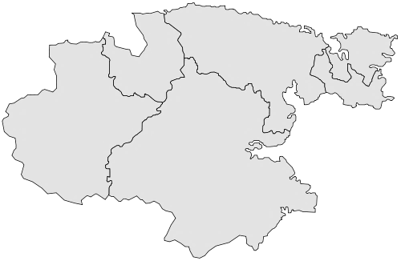
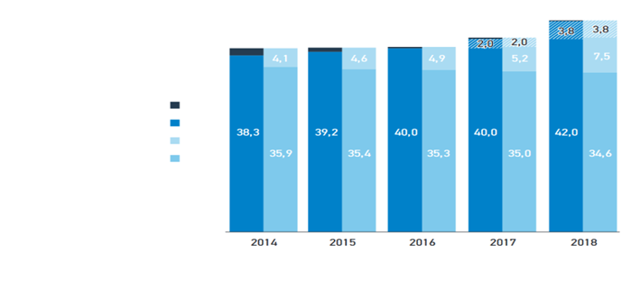
Sales market
NPO Economics and Direct Investment Development Fund of the Chukotka Autonomous Region
Sale of compressed gas and part of the oil products for the needs of Chukotka AR
Sale of oil products on the markets of the Far East and Russia
Oil exports to foreign markets (Japan and China)
Russian Federation
Far East
Breakdown of oil demand and consumption
Pevek
240 km
Chukotka
Autonomous
Region
Import
Production
Export
Demand on domestic market
Zapadno-Ozernoye and Telekaiskoye fields
Anadyr
Source: VYGON consulting
12%
The oil field is well placed in relation to Asia-Pacific customers of oil products.

Slide 6
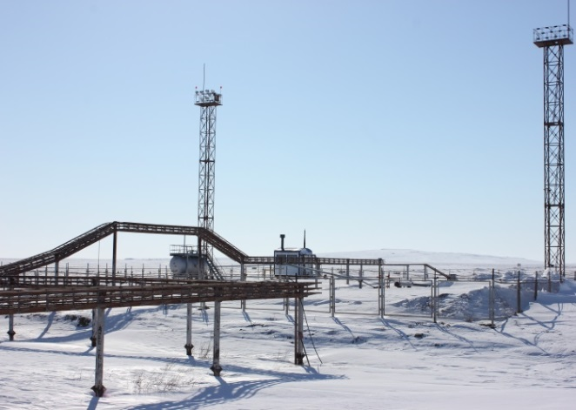
Incentive package
NPO Economics and Direct Investment Development Fund of the Chukotka Autonomous Region
TAXES
Tax preferences of the special economic zone
PSEDA BERINGOVSKY
Easy-term loans
FINANCIAL
Subsidies for hiring and training personnel
Free customs zone regime
Developed infrastructure
Land and infrastructure
Low utilities costs
Low land rental rates

Slide 7
ZAPADNO-OZERNOYE AND VERKHNE-TELEKAISKOYE OIL, GAS AND CONDENSATE
NPO Economics and Direct Investment Development Fund of the Chukotka Autonomous Region
THANKS FOR YOUR ATTENTION!
Contact details:
Olga Sergeyevna Plotnikova
Director, NPO Economics and Direct Investment Development Fund of the Chukotka Autonomous Region.
Phone: +7(427 22) 6-93-29
www.fond87.ru
Alexander Valentinovich Kabysh
Director General of Sibneft-Chukotka LLC
+7(42722)6-44-46, 6-44-47, http://sibneft.org/

